Slide 1
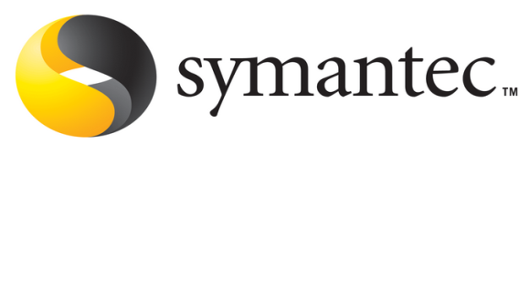
Cluster Clock Synchronization
Sponsored by :
Symantec Corp.
External guide :
Mr. Avinash Patil.
Internal guide:
Prof. Vivek Deshpande.
Project members :
1. Divyanshu Shekher
2. Neha Doiphode
3. Dhanashree Kashid
4. Anuja Kench

Slide 2
clock synchronization
Time is a quantity which we often want to measure accurately.
In Distributed systems, there is no common clock or other precise global time source exists.
A clock synchronization service ensures that spatially dispersed processors in a distributed system share a common notion of time.
To behave as a single, unified computing resource, distributed systems need clock synchronization service.
Synchronized clocks are useful in the distributed systems for performance measurements, auditing, event ordering etc.
E.g ‘make’ utility in Linux.
Notes:
make recompiles if foo.c is newer than foo.o
Scenario :make on machine A to build foo.o
Test on machine B; find and fix a bug in foo.c
Re-run make on machine B

Slide 3
Need of Clock Synchronization
Temporal ordering of events produced by concurrent processes
Synchronization between senders and receivers of messages
Coordination of joint activity
Serialization of concurrent access for shared objects

Slide 4
Logical & Physical Clocks
Logical clock keeps track of event ordering.
-In this, what matters is not the time of day at which the event occurred but that all processes can agree on the order in which related events occur.
Physical clocks keep time of day.
-With physical clocks, the interest is not in advancing them just to ensure proper message ordering, but to have the system clock keep good time.

Slide 5
Modes of synchronization
External synchronization
Source of synchronization is UTC time.
Internal synchronization
No external source of time.
Clocks are synchronized with one another to a known degree of accuracy.
Usually loosely coupled systems use external synchronization and tightly coupled systems use internal synchronization.
Notes:
UTC-Co-ordinated universal time
Logical synchronization –lamport ex.
We are doing Physical synchr.
Loosely and tightly coupled systems.

Slide 6
Approaches for clock synchronization
Software approach
Does not require specialized hardware.
Uses system time for synchronization.
Hardware approach
Requires a specialized hardware which is capable of time stamping.
Hybrid approach
A hardware assisted software synchronization .

Slide 7
Why clocks differ ?
Getting two systems to agree on time is a tough task :
Two clocks hardly ever agree
Quartz oscillators oscillate at slightly different frequencies
Reasons :
Environmental factors
Temperature
Air circulation
Pressure
Initial manufacturing tolerance
Aging
Mechanical stresses such as ‘vibrations’

Slide 8
Clock Skew & Clock Drift
Clock drift
Clocks run at slightly different frequencies.
Thus they count time at different rates.
Clock skew
Difference between two clocks at one point in time
Notes:
So clocks diverge.

Slide 9
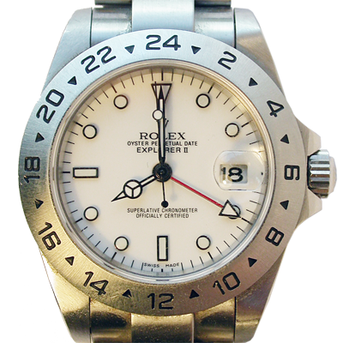
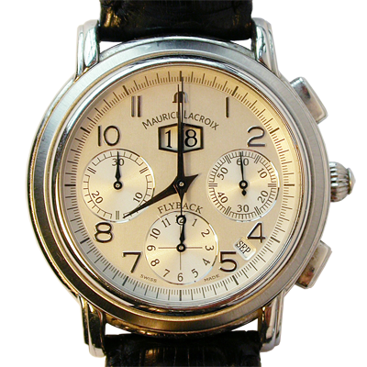
8:00:00
8:00:00
Sept 18, 2006
8:00:00

Slide 10
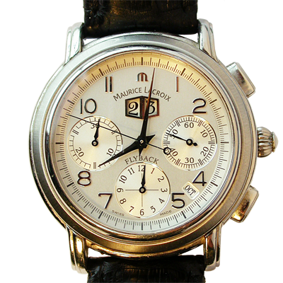
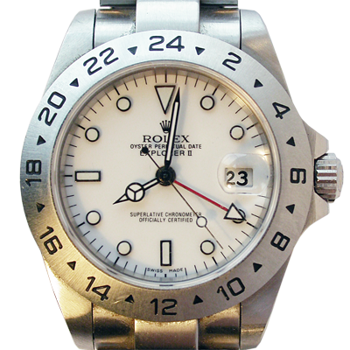
8:01:24
8:01:48
Skew = +84 seconds
+84 seconds/35 days
Drift = +2.4 sec/day
Oct 23, 2006
8:00:00
Skew = +108 seconds
+108 seconds/35 days
Drift = +3.1 sec/day

Slide 11
Clock sources in Linux
Criteria | RTC | HPET | Jiffies | TSC
Basic information | RTC (real time clock) is usually integrated into south bridge of the motherboard. | It is a high precision clock source due to its very low jitter. | Based on timer interrupt & referred to as kernel heartbeats. | 64-bit register. It counts number of ticks since last boot or reset.
Frequency | 3.579545 MHz | 10 MHz which is not appropriate for high resolution timestamping. | Frequency can be specified at compile time. Min = 1/250 Hz. Max = 1/1000 Hz. | TSC operates at CPU’s clock frequency. Constant TSC feature ensures uniform tick rate at max CPU frequency
Precision | Clock frequency limits the precision to microsecond level. | Nanosecond level | Millisecond (1 to 4 ms) level which is far from proper timestamping. | Provides excellent high-resolution precision upto 1 nanosecond.

Slide 12
Project Overview
Phase I
Establish master-slave architecture.
Exchange time stamped packets between the master and slaves.
Phase II
Calculate delay and offset.
Use delay & offset in synchronization.
Run the synchronization algorithm to synchronize slaves with the master.

Slide 13

Establishment of master – slave architecture
INIT
Master
INIT
INIT
Slave I
Slave III
Slave II

Slide 14
Phase I
Master
Slave
INIT
T1
Sync (T1)
T2
Delay request
T4
T3
Delay response (T4)

Slide 15
Implementation of phase I
Use of enhanced libpcap for nanosecond timestamping of captured packets.
Modification of enhanced libpcap for timestamping outgoing packets upto nanosecond level precision by writing an IOCTL.
Obtaining all four timestamps : T1 , T2 , T3 , T4 in nanoseconds.

Slide 16
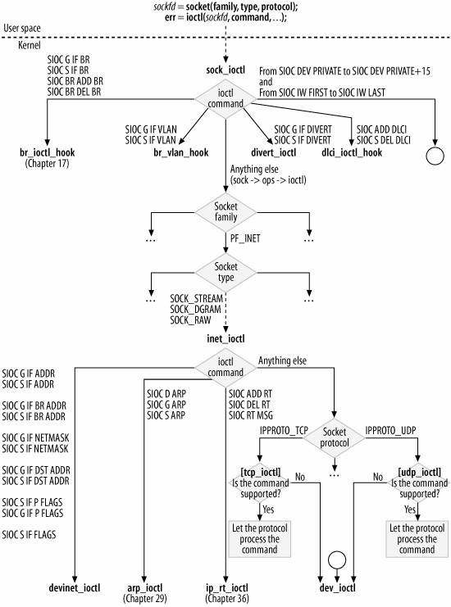
Flow of IOCTL

Slide 17
Packet capturing Library : Libpcap
Open Source packet capturing library used by various
packet sniffers such as Wireshark etc.
Provides API’s for sending and Receiving packets
Captures packets and timestamps them at microsecond
resolution
Provides accurate timestamps

Slide 18
Application Layer
Application Layer
Libpcap
Libpcap
Socket
Raw
Transport Layer
Transport Layer
Raw
Socket
Network Layer
Network Layer
Data Link Layer
Data Link Layer
Physical Layer
Physical Layer
Frame

Slide 19
Phase II
Calculate delay and offset between master and slave to synchronize clocks to very tight bounds.
Slave’s time after adjustment = Slave’s current time + offset
Slave’s frequency adjustment factor =
(3600 + offset) / 3.6

Slide 20
Implementation of phase II
1 .Calculating delay and offset .
Delay + Offset = T2- T1 ……………I
Delay – Offset = T4-T3 …………….II
From I and II,
Delay = (( T2-T1 ) + (T4-T3))/2
Offset = ((T2-T1)-(T4-T3))/2
2 . Use of calculated delay and offset for adjusting slave’s system time according to master.

Slide 21
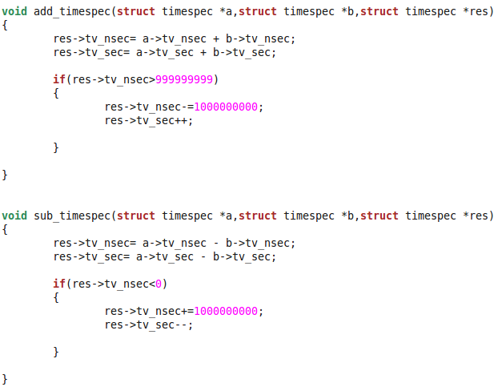
Snapshot of code snippet– Adjustment of seconds and nanoseconds

Slide 22
Comparison with NTP
Criteria | NTP | Proposed algorithm
Architecture | Has a hierarchical design consisting of number of timeservers and clients. Each timeserver is assigned a “stratum” level corresponding to its distance from the accurate time source. | Master – slave architecture.
Mode of operation | Client pulls time from server. | Master pushes time to slaves.
Approach of synchronization | Software approach | Software approach
Mode of synchronization | External synchronization | Internal synchronization
Precision | 10-100 millisecond level of precision. | Nanosecond level
Environment | WAN | LAN

Slide 23
Comparison with PTP
Criteria | PTP | Proposed algorithm
Architecture | Master – slave architecture. | Master – slave architecture.
Mode of operation | Master pushes time to slaves. | Master pushes time to slaves.
Approach of synchronization | Hybrid approach | Software approach
Mode of synchronization | Internal synchronization | Internal synchronization
Precision | 20-100 nanosecond level of precision. | Nanosecond level
Environment | LAN | LAN

Slide 24
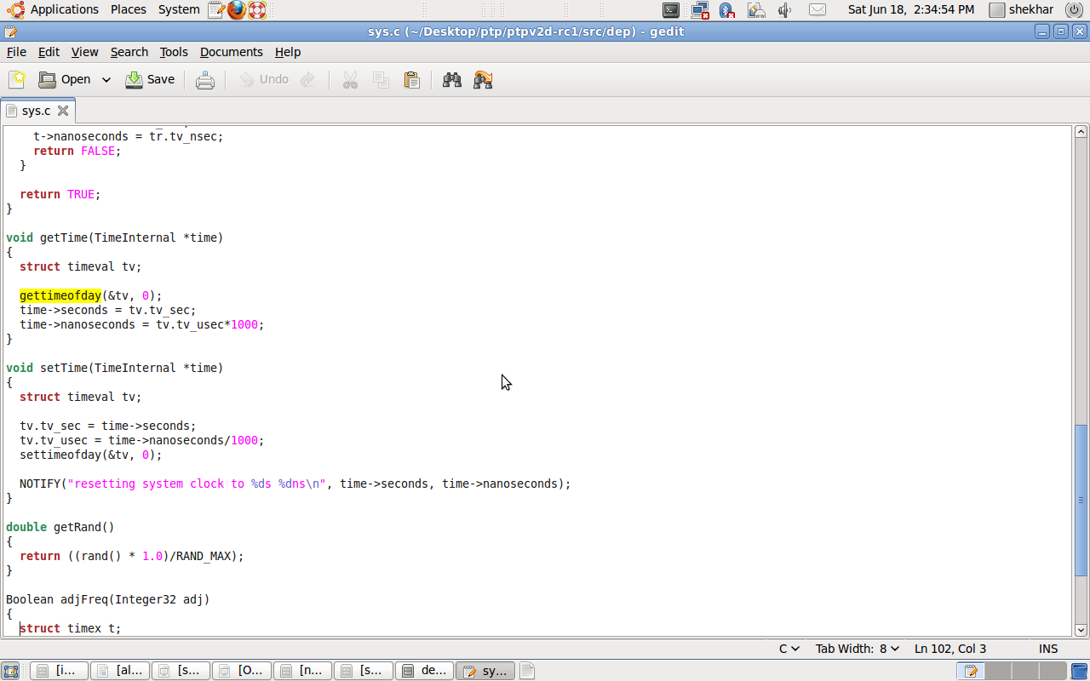

Slide 25
Applications of nanosecond precision
1.High speed precision in bank trading
2.Log management
3.Bandwidth usage
4.network fault detection.
5.Military electronic systems that encode ,decode , present,transport real time data.
e.g :- 1)Weapon test systems
2)Distributed sensor networks.
3) Radar processing
4)Signal intelligence
6.Deep space networks
7.Real time Multimedia and control applications

Slide 26
Limitations
Protocol is currently designed for LAN environment.
Election algorithm is not currently implemented in case of failure of master
Protocol works in homogeneous cluster environment.

Slide 27
Conclusion
Clock Synchronization is an important issue in any fault-tolerant distributed system and has been extensively studied in recent years.
Protocol synchronizes nodes in the cluster to very tight bounds (upto nanosecond precision).

Slide 28
References
Understanding the Linux kernel: O’reilly publications.
Linux device driver 3rd edition: O’reilly publications.
Understanding Linux Network Internals: O’reilly publications.
Unix Network programming, vol-1 – Richard Stevens.
Distributed Operating Systems – Tanenbaum.
Software based packet capturing with high precision time stamping for Linux by Peter Orosz.
Time synchronization in a local area network by Svein Johannessen.
Synchronizing Networks with IEEE 1588 by Alexander Tan.
IEEE 1588 Implementation and performance of time stamping techniques by Hans Weibel.
High-Precision relative clock synchronization using Time Stamp Counters by
Guo-Song-Tian,Yu-Chu-Tian and Colin Fidge.

Slide 29
THANK YOU !

